Slide 1
Game Development 2B
The Decorator Pattern

Slide 2

Adding functionality at runtime
Decorator is used for adding functionality to objects at runtime
01
Useful for not changing the code of underlying classes
02
Useful when working with someone else’s code
03

Slide 3
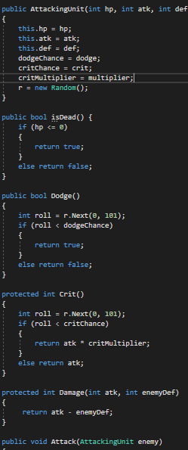
Looking at traditional functionality
AttackingUnit is a good class
Everything is generic
It can be used for Dragon and Knight
How do we add functionality to this game?

Slide 4
New functionality
New functionality would force us to create new methods in AttackingUnit for Dragon or Knight to use
1
This means we have to change the underlying classes
2
If we create new class types, we’d be forced to override any functionality that doesn’t speak to our generic implementation
3
Classes should be open for extension but closed for modification
4

Slide 5
Decorating objects
We take some base object
“Decorate it” with class functionality from different hierarchy implementations at runtime
A Hero needs Stats
An NPC needs Barks
A Party member could have Stats (for fighting) and Barks (for banter)

Slide 6
Decorating objects
Decorators have the same supertype as the objects they decorate.
You can use one or more decorators to wrap an object.
Given that the decorator has the same supertype as the object it decorates, we can pass around a decorated object in place of the original (wrapped) object.
The decorator adds its own behaviour either before and/or after delegating to the object it decorates to do the rest of the job.
Objects can be decorated at any time, so we can decorate objects dynamically at runtime with as many decorators as we like.
Note: Because decorators are the same type as the base type, this can become unreadable or confusing

Slide 7
decorator
The Decorator Pattern attaches additional responsibilities to an object dynamically. Decorators provide a flexible alternative to subclassing for extending functionality.

Slide 8
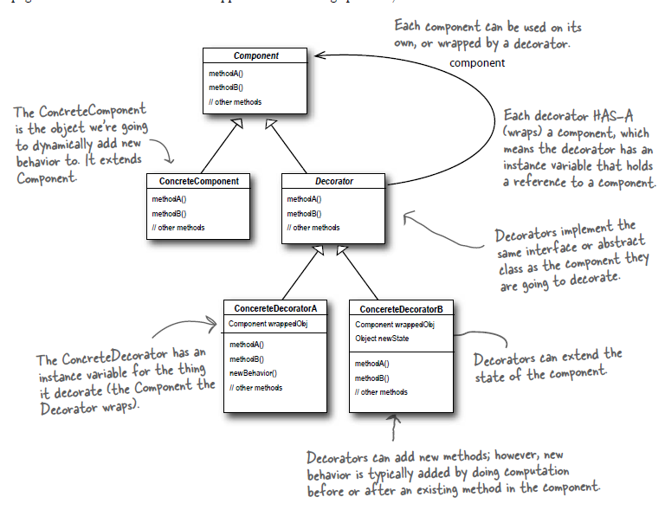
Decoration hierarchy

Slide 9
Wrapping objects
Decorators wrap objects of the necessary base class
01
It’s like putting on suits
02
When your base object is in a certain suit, he has access to certain powers/functionality
03
Similar approach to having components that can switch out like with the Strategy pattern, but it’s more all-encompassing
04
You ARE the suit
05

Slide 10
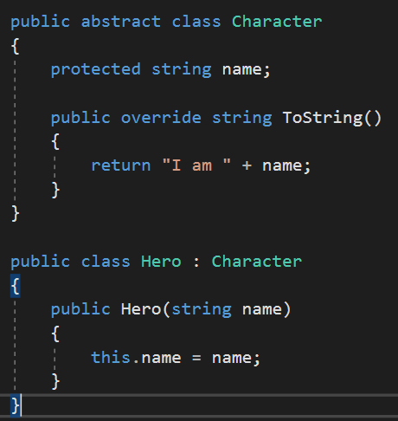
Creating the base wrappable object

Slide 11
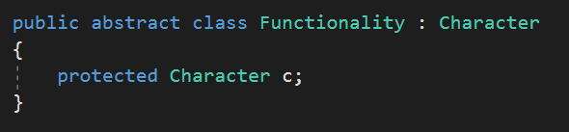
Creating the suits
All suits wrap a character

Slide 12
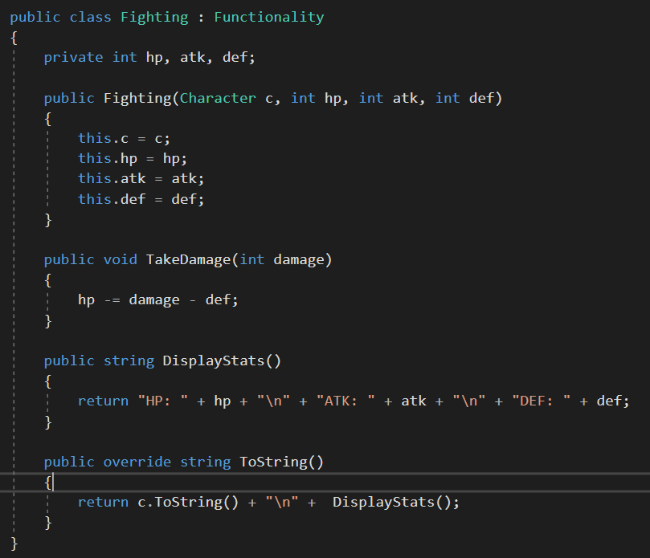
Creating the suits
These extend our abstract suit class
While I’m wearing a suit, I have access to its functionality
I still have access to any protected variables above me in the hierarchy

Slide 13
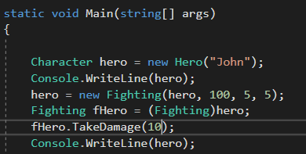
Using suit functionality
We need to cast because hero is not initially wearing the Fighting suit, so the compiler doesn’t know
Making the temporary variable allows us to use functionality before we switch suits
Keeping the temporary variable always gives us access to that suit later

Slide 14
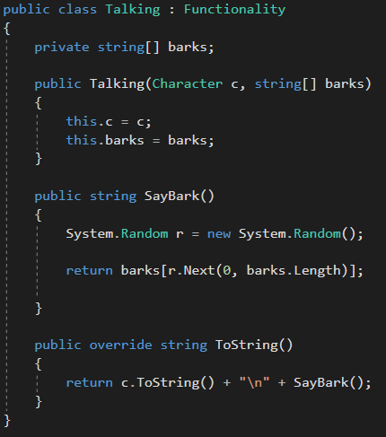
A different suit
While wearing the Fighting suit, our Hero can Fight
While wearing the Talking suit, he can only talk
This is because there’s no combination suit
However, if I changed from a Fighting Suit into a Talking Suit, I’ve put my Talking Suit over my Fighting Suit, so I do, in theory, have access to Fighting functionality (through my character wrapper)
This isn’t really what decorator is used for though

Slide 15
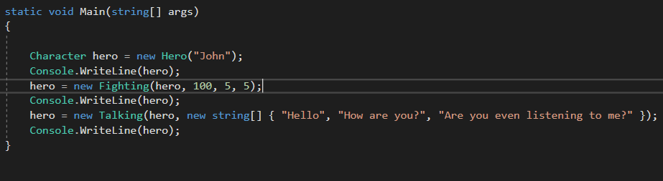
The full suit

Slide 16
problems
Once you put on a new suit, the only way back to the old suit is to keep a reference to that suit
Putting on a new suit may reset functionality
Decorators don’t necessarily know about the object they’re wrapping
I don’t know when I put on the Talking suit that I was wearing the Fighting suit
Adding Decoration classes often complicates the code to make it confusing
Fighting Suit inherits from Character? What? Surely a character HAS a Suit…
Of course, HAVING a suit REQUIRES it

